Slide 1

Wednesday 17 February 2016

Slide 2
Agenda
12.00 Introductions and updates (Tariq)
12.20 Careers activity 1 (Jacek)
12.40 Careers data analysis (Liz)
13.00 Careers strategy (Jacek, Tariq & Joy)
13.30 Introduction and Q&A with Rob Wallach
13.50 AOB
14.00 End of meeting

Slide 3


Network Chair’s Introduction
@dtmasood

Slide 4


Purposes of the Network
Share best practice, ideas and experiences between departments
Provide a representative postdoc ‘voice’
Provide face to face advice, support & training for existing departmental postdoc committees
Provide guidance and support for postdocs and departments in setting up new departmental postdoc committees
Notes:
Included here as a number of representatives from committees are new!

Slide 5
Prioritised Postdoc Needs (DPCCN, May 2014)
Postdocs need opportunities / support / access to following:
1
2
3
4
Research Excellence & Recognition
Strategic Career Plan & Progression
Leadership & Teaching
Representation at Dept. & University
5
6
7
12
8
Appropriate & Timely Mentoring
Meaningful Professional Review
Personal & Professional Development
Moving to Careers Outside Academia
9
10
11
13
Networking (Professionally & Socially)
Timely Induction & Welcome in Cambridge
Alumni benefits on leaving Cambridge
College Affiliations

Slide 6
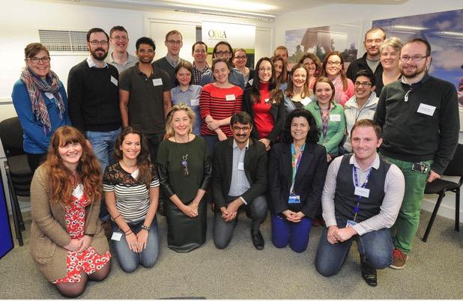
2015/16 Strategy
Personal & Professional Development
Strategic Career Plan & Progression
Leadership & Teaching
Mentoring
May 2015

Slide 7
Strategic Career Plan & Progression (DPCCN, May 2014)
Postdocs need opportunities / support / access to following:
1
2
3
4
Research Excellence & Recognition
Strategic Career Plan & Progression
Leadership & Teaching
Representation at Dept. & University
5
6
7
12
8
Appropriate & Timely Mentoring
Meaningful Professional Review
Personal & Professional Development
Moving to Careers Outside Academia
9
Networking (Professionally & Socially)
“postdocs have strategic career plan and progression”

Slide 8
Strategic Career Plan & Progression
Scattered activities
Job 1
Careers strategy
Job 2
How?
What Attributes?

Slide 9
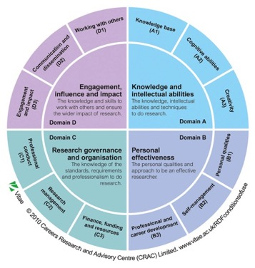
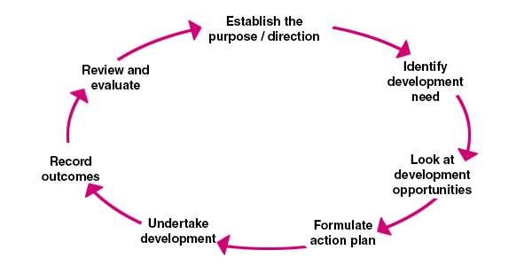
Strategic Career Plan & Progression Examples
Vitae RDF
CMI Action Checklist

Slide 10


Strategic Responsibility
“Concordat to support the career development of researchers”
Principle 3
Researchers are equipped and supported to be adaptable and flexible in an increasingly diverse, mobile, global research environment.
Principle 4
The importance of researchers’ personal and career development, and lifelong learning, is clearly recognised and promoted at all stages of their career.
Principle 5
Individual researchers share the responsibility for and need to pro-actively engage in their own personal and career development, and lifelong learning.
http://www.pdoc.cam.ac.uk/dpccn/ConcordatHRexcellence
Notes:
University is a signatory of the concordat

Slide 11
Updates

Slide 12
Staff Review and Development
Autumn 2014 DPCCN formed a working group on SRD. Two main findings
The purpose of SRD was misunderstood by both line manager and postdoc
Desire to increase participation rates (on-line system could improve the administration)
Outcomes:
- HR have now published some postdoc guidance on the HR website ‘Career Management Processes: Guidance for Contract Research Staff’ - New online SRD system has been rolled out in Autumn 2015. Postdocs involved in user testing.
Find out more:
HR will run an information session for DPCCN on Friday 4 March 2016 1-2 pm in the Postdoc Centre
http://www.hr.admin.cam.ac.uk/policies-procedures/staff-review-and-development/career-management-processes-guidance-contract

Slide 13
Contribution Increment Scheme
Termly exercise for contract research staff. All postdocs employed by the University of Cambridge should receive the information each term BUT
(1) It applies to employees of the University of Cambridge.
(2) Your PI / department will need to confirm availability of funding for the increment rise.
In the last 5 years there have been 963 successful applications
Grade 7 – 629 successful applications (149 in 2015)
Grade 9 – 188 successful applications (46 in 2015)
This term’s scheme is now open with effect from 1 April (deadline 18 March).
http://www.hr.admin.cam.ac.uk/pay-benefits/pay-and-reward/reward-policies/reward-schemes/contribution-increment-scheme-researchers

Slide 14
Mentoring Update
Partner departments: Vet School, Chemical Engineering, and the Clinical School.
Work plan:
Current: Building a mentor pool in the partner departments
March: Matching of postdocs in partner departments.
May/June: Application and matching of mentoring for postdoctoral community (outside of partner depts).
first come, first serve basis.
training is mandatory (mentors will also receive training)
Note: Minimum contract time has been reduced to 18 months
Input from DPCCN:
Mentor recommendations (will be treated as anonymous) both within partner departments and other departments
http://www.opda.cam.ac.uk/whileincambridge/mentoring
Notes:
Update from Libbi Johnson (mentoring coordinator)

Slide 15
Researcher Development
October 2015
DPCCN drafted a paper about engagement with Research Development (RD)
Paper well received by RD project officer
Findings consistent with RD review phase I
Updates:
RD review phase II – RD provision by Schools
RD online log facility under development (launch Autumn 2016)
Show range of education on offer
Encourage participation in each broad area
Logging facility for transcript printing

Slide 16
Support for Strategic Career Planning
Ownership and responsibility is with the Postdoc
Wealth of central University training, resources and opportunities
BUT departments and line managers could be more supportive (time and awareness)
‘Training’ is not enough – need to embed skills
Advice of doing ‘more’ research is not enough
Academic ‘vs’ non-academic positions Correct question: ‘how do I find the ‘right’ position to fulfill my needs?’
Long term postdocs and career paths within Cambridge

Slide 17
Postdoc experiences “career time axis”
ACTIONS
CAREER MILESTONES
TURNING POINTS
Share and discuss!

Slide 18
CROS 2015
Careers in Research Online Survey (CROS) completed by 631 research staff
58.2% have participated in Staff review (SRD) in the last 2 years
53.4% in 2013, 40.4% in 2011, 32.7% in 2009
of these 54% found it useful/very useful in helping them to focus on career aspirations

Slide 19
Notes:
% of respondents

Slide 20
Notes:
% of respondents

Slide 21
Notes:
% of respondents

Slide 22
Notes:
% of respondents

Slide 23
Postdoc experiences summary of “career time axis” group activity
MOTIVATIONS – what or who makes postdocs to engage in career progression-related activities?
COMMITMENT – how much time and effort do postdocs put into career progression?
STUMBLING BLOCKS – what prevents postdocs from active career planning?

Slide 24
Postdoc recommendations
DESIRES – what postdocs would like to do / be able to do to circumvent obstacles in their career planning?
Peer-2-peer recommendations
Institutional recommendations

Slide 25
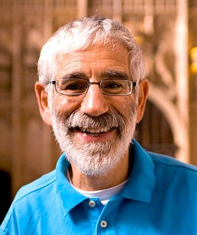
Q&A with Rob Wallach
Director, Office of Postdoctoral Affairs

Slide 26
AOB
Staff Review and Development information for postdocs Friday 4 March 12-1.30pm, Postdoc Centre
PdOC Postdocs and Teaching Monday 7 March 6pm
PdOC Postdocs and College Affiliations Wed 23 March 6pm
Offer from Jeremy Sanders (KP)
Vitae membership and resources (JW)

Slide 27

Vitae Resources – more than the wheel

Slide 28
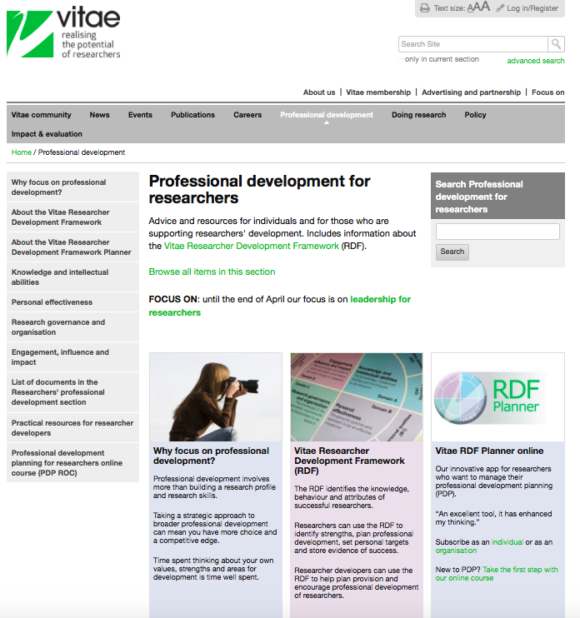
https://www.vitae.ac.uk/researchers-professional-development

Slide 29
Vitae Resources – more than the wheel
Professional Development Planning for researchers online course
https://www.vitae.ac.uk/researchers-professional-development/professional-development-planning-for-researchers-online-course-pdp-roc
Career Management for researchers
https://www.vitae.ac.uk/researcher-careers/career-management-for-researchers
Supervising a doctorate
https://www.vitae.ac.uk/doing-research/supervising-a-doctorate

Slide 30
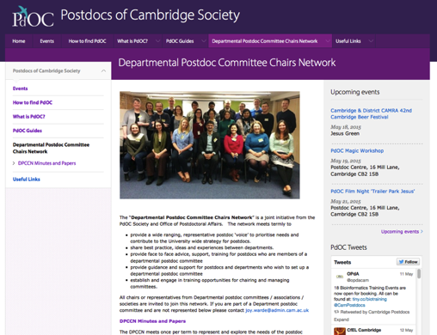
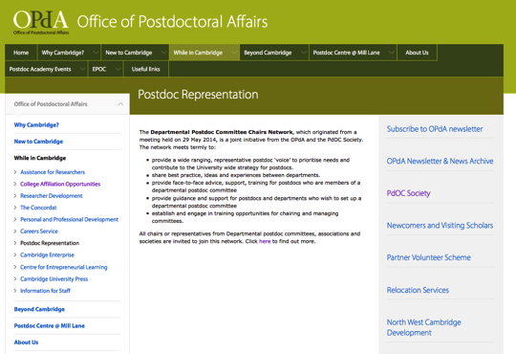
Information
www.pdoc.cam.ac.uk/dpccn

Slide 31
Next Meeting
To be confirmed

