Slide 1

Wednesday 18 May 2016

Slide 2


Slide 3
Agenda
6.00 Introductions and updates (Tariq/Joy)
6.20 Focus on Leadership (Tariq/Andy)
6.40 Postdoc Needs (Joy)
What does success look like?
7.20 DPCCN priorities for 2016/17 (Joy)
7.50 AOB
8.00 End of meeting

Slide 4


Purposes of the Network
Share best practice, ideas and experiences between departments
Provide a representative postdoc ‘voice’
Provide face to face advice, support & training for existing departmental postdoc committees
Provide guidance and support for postdocs and departments in setting up new departmental postdoc committees

Slide 5
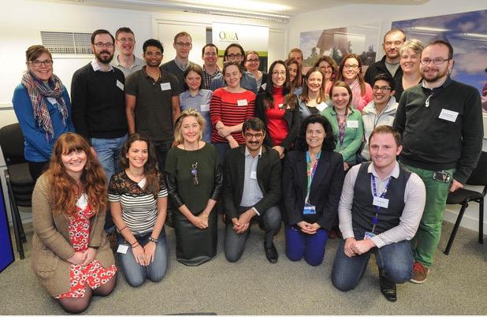
2015/16 Strategy
Personal & Professional Development
Strategic
Career Plan & Progression
Leadership & Teaching
Mentoring
May 2015

Slide 6
Updates
All new postdocs are invited to a ‘Getting Connected’ postdoc induction.
Two new Researcher Development consultants for postdocs have been appointed.
College affiliation funding scheme to increase and embed postdoctoral affiliation schemes has been launched.
New on-line SRD process being promoted to departments.
Postdoc Centre @ Mill Lane until 2019.

Slide 7
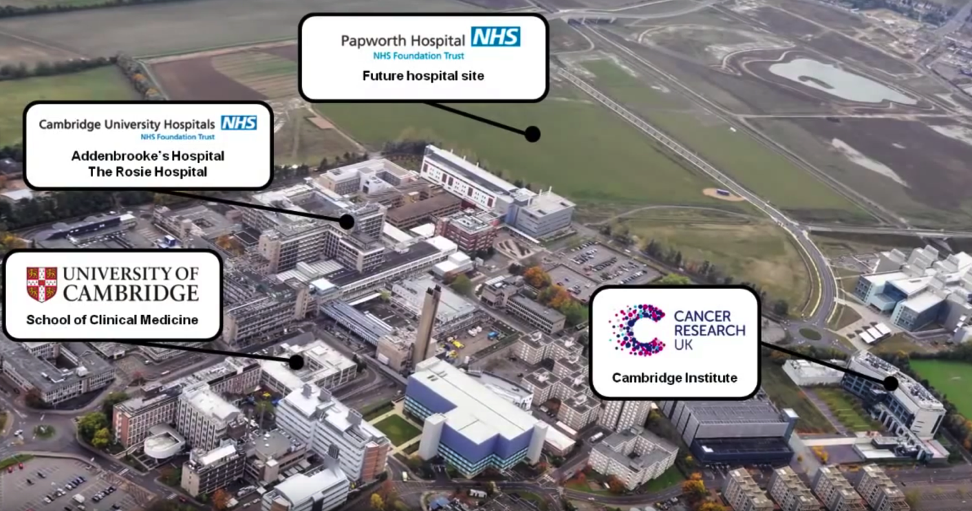
Postdoc Centre @ Biomedical Campus
To open: August 2016

Slide 8
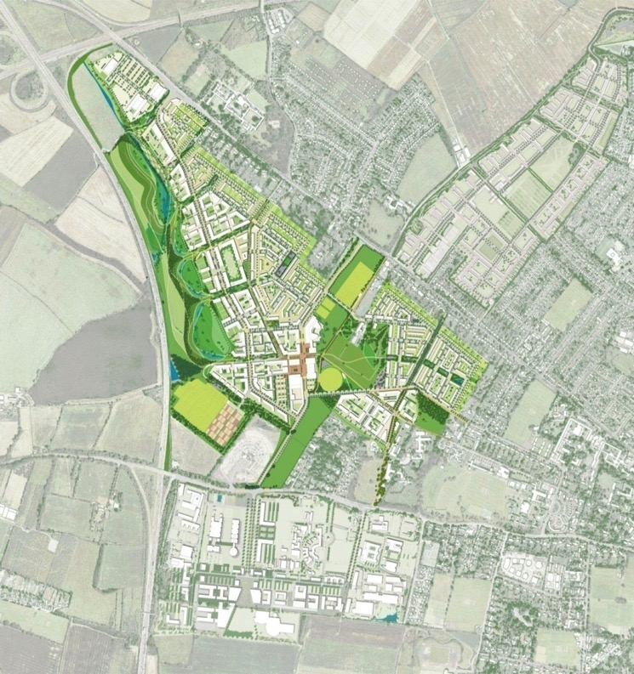
Postdoc Centre @ NW Cambridge
Phase 1
700+ units for key worker housing (mostly research staff) from Jan 2017
Supermarket, shops, café, hotel health centre, primary school, nursery, community centre.
Postdoc Centre Late 2017
Open to ideas on potential uses of the postdoc centre

Slide 9
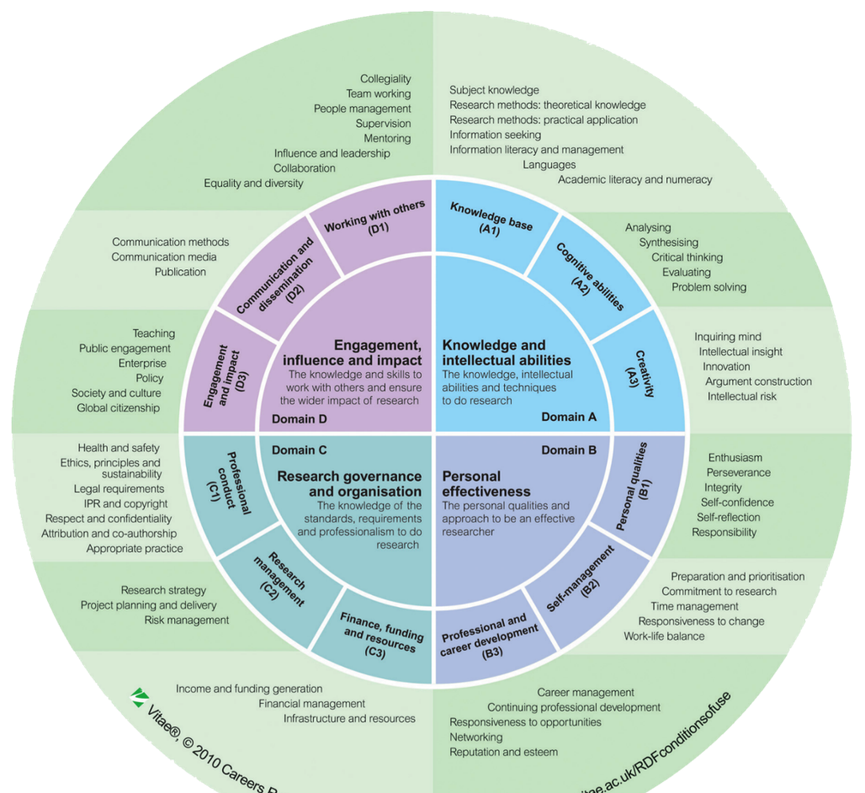
Vitae Researcher
Development
Framework
(RDF)
Describes the knowledge, behaviours and attributes of successful researchers
Use it to assess your strengths and identify areas for further development
Cambridge trial for Postdocs and PhD students from Sept 2016.
Melissa.Koops@admin.acm.ac.uk
www.vitae.ac.uk/rdf

Slide 10
Mentoring Pilot
Partner departments:
Vet School, Chemical Engineering, Physics and the Clinical School.
Work plan:
Current: Building a mentor pool in the partner departments
and mentor/mentee matching.
June: Applications and matching of mentees for
postdocs (outside of partner depts).
Deadline for applications 9am 20 June
Mentoring information evening 6pm 15 June
http://www.opda.cam.ac.uk/whileincambridge/mentoring
Notes:
Update from Libbi Johnson (mentoring coordinator)
Input from DPCCN:
Mentor recommendations (will be treated as anonymous) both within partner departments and other departments

Slide 11
Leadership

Slide 12
Network Priorities and Strategy
Notes:
Spend rest of the meeting looking at
refreshing postdoc needs list, Thank you for your homework
work out how we can measure progress – in 2, 5, 10 years time how could we show progress?

Slide 13
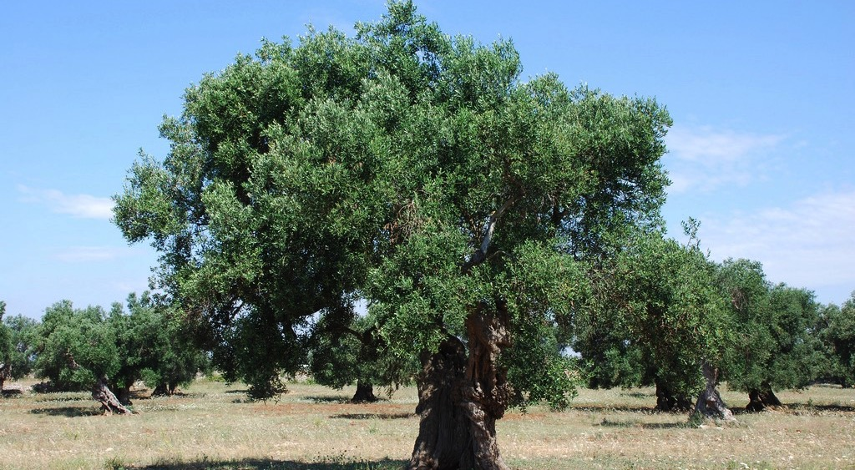
Notes:
University as 800 year old olive tree. Fruitful, gnarly underneath.

Slide 14
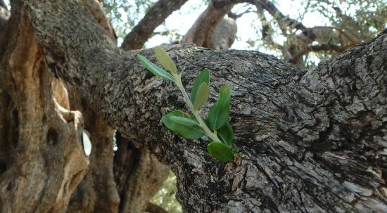
Notes:
The creation of DPCCN, OPdA, postdoc centre was a new shoot on an existing structure.
Cast your minds back to 2014. Postdoc centre was opening in May 2014 and we had no idea how it would be used. Also we invited contacts/reps of departments for the first DPCCN meeting and to summarise your needs. Generated 13 postdoc needs.

Slide 15
Prioritised Postdoc Needs
(DPCCN, May 2014)
Postdocs need opportunities / support / access to following:
1
2
3
4
Research Excellence & Recognition
Strategic Career Plan & Progression
Leadership & Teaching
Representation at Dept. & University
5
6
7
12
8
Appropriate & Timely Mentoring
Meaningful Professional Review
Personal & Professional Development
Moving to Careers Outside Academia
9
10
11
13
Networking (Professionally & Socially)
Timely Induction & Welcome in Cambridge
Alumni benefits on leaving Cambridge
College Affiliations
Notes:
ITS TIME TO REVSIT THIS LIST
THANKS FOR HOMEWORK

Slide 16

Homework key messages
All needs still relevant
  Alumni benefits already in place
  Acknowledgement of central induction
Explicit needs of
  pay and cost of living in Cambridge
  family support
  sports facilities / societies
  working conditions (space)
  travel funding (conferences)
  progression/promotion within Cambridge
  series of short term contracts
  long term ‘postdocs’. How are they valued/recognised?
  ‘token’ change (policy implementation); how is change measured

Slide 17
Postdoc Needs
(A) Management
- PI / line manager
- HR processes
- Department
(D) Welfare
family/partner
housing
(B) Career progression
Researcher Development
(C) Representation
Integration
Recognition
Notes:
Needs divided into 3 themes.
This is a somewhat artificial division for the purposes of dividing the group work.

Slide 18

What does ‘success’ look like?
Where are we now?
How can we get there?
Where do we want to go?
What does success look/feel like?
How could we monitor and measure success?
Notes:
How do we know if we are making progress against any of these needs? What would success look like? How can we measure it? How do we know that we’ve got there? How can we measure progress
IN another 2 years time how can we show that we have made progress?

Slide 19
Need | Where are we now? | Where do we want to go? | How can we measure success?
Postdocs have a meaningful professional review
start

Slide 20
Need | Where are we now? | Where do we want to go? | How can we measure success?
Postdocs have a meaningful professional review | CROS 2015 survey 58.2% have participated in Staff review (SRD) in the last 2 years. 53.4% in 2013, 40.4% in 2011, 32.7% in 2009 of these 54% found it useful/very useful in helping them to focus on career aspirations | 90% of postdocs having a review within 1 year of probation. What about short term postdocs? | HR return rates Postdoc survey data – participation rates and usefulness Policy change to every year.
Based on feedback, there are suggested changes of wording to each need. Please edit/amend.

Slide 21
Postdoc Needs
(A) Management
- PI / line manager
- HR processes
- Department
(D) Welfare
family/partner
housing
(B) Career progression
Researcher Development
(C) Representation
Integration
Recognition

Slide 22
What next?

Slide 23
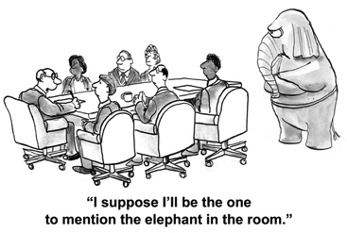
Themes for 2016/17
Notes:
SUSTAINABILITY
POSTDOC ENGAGEMENT
RECRUITMENT OF NEW MEMBERS / YOUR WORK LOAD

Slide 24

Themes for 2016/17
Committee sustainability
Postdoc Engagement
Recruitment of new members
Your workload (priorities).

Slide 25
Themes for 2016/17
What would be most useful for your committee?
  DPCCN termly meetings
  Personal and ctte training opportunities
  Director of Postdoctoral Affairs and OPdA
  ???
What has worked for your ctte?
What has not worked (and why?)
What support and resource is needed?
How would you like to use the DPCCN next year?
Notes:
Through open to floor for discussion.
What would be most useful for your committee
Elephant in the room
Committee integration/funding/sustainability
Integration into department?
What worked?
What didn’t work (and why)?
What is needed in terms of resources?
“Blue sky thinking” (one new idea – no restrictions)

Slide 26
AOB
PdOC Masterclass Part 1 “Prepare yourself for leadership”
22 June 9:30am-12:30pm
PdOC Masterclass Part 2 “Leading others”
22 June 1:30pm-4:30pm
PdOC Society AGM and election of a new committee 14 June, 6.30pm at King’s College
Researcher Development Committee – reps from Clinical school / Engineering / Arts, Humanities, Social Sciences

Slide 27
Next Meeting
To be confirmed

