Slide 1
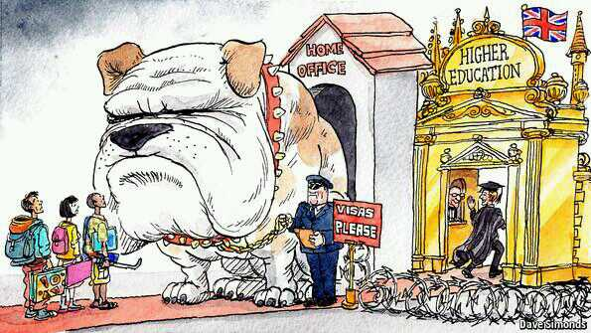
PdOC Immigration Session 2017
Graeme Ross, Immigration and Compliance Manager

Slide 2
Topics for discussion
EEA nationals
Current legal position
Permanent Residence eligibility and procedure
Citizenship
Non-EEA nationals
PBS & dependant overview
Settlement
Citizenship

Slide 3
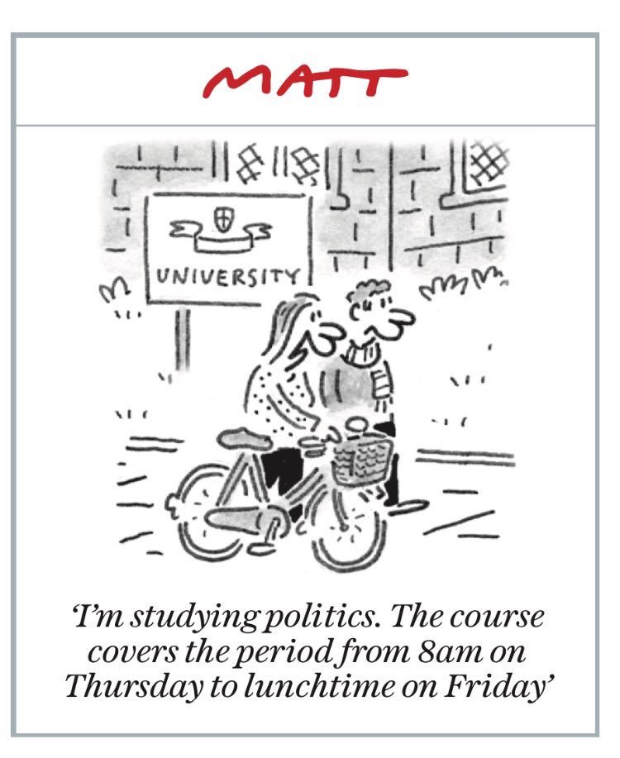
‘Brexit’
No change to status of EEA nationals in the
UK until formal exit completed.
Article 50 of Lisbon Treaty:
Triggered March 2017?
Formal notification by UK to EU of
intention to leave
Minimum 2 year process. Could be longer. All 27 EU states must agree on terms of exit.

Slide 4
Statement on EEA resident’s rights
“Securing the status of, and providing certainty to, EU nationals already in the UK and to UK nationals in the EU is one of this Government’s early priorities for the forthcoming negotiations.
The Government would have liked to resolve this issue ahead of the formal negotiations. And although many EU Member States favour such an agreement, this has not proven possible. The UK remains ready to give people the certainty they want and reach a reciprocal deal with our European partners at the earliest opportunity. It is the right and fair thing to do.”
‘Brexit Bill’ presented to Parliament, 1 February 2017

Slide 5
Current rights of EEA nationals
Free movement law
Directive 2004/38/EC
Immigration (European Economic Area) Regulations 2006/2016
Right of residence if:
Working, looking for work (max 6 months) or self employed - Must be ‘genuine and effective’ and not ‘marginal and supplementary’. Min: £663pm
self sufficient
studying
Permanent residence:
granted automatically after 5 years of living in the UK while exercising Treaty rights in one or more of above categories

Slide 6
Options
EEA Residence Card/Certificate
Denotes only that you are currently exercising EEA rights in the UK.
Unknown ‘usefulness’ after Brexit
EEA Permanent Residence Card/Certificate
Denotes that you have exercised Treaty rights in the UK for at least 5 years.
Most ‘popular’ card to obtain. Not mandatory, but you may wish to consider applying if eligible. Does no harm!
See EEA FAQ: http://www.hr.admin.cam.ac.uk/hr-services/immigration/eea-staff-and-immigration-options

Slide 7
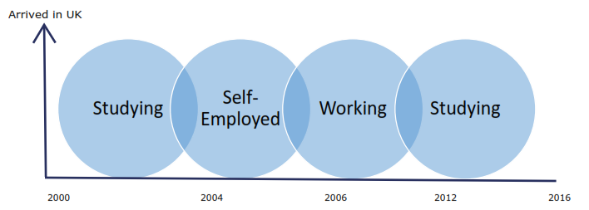
Permanent Residence eligibility

Slide 8
How to apply for PR Card
Online (sole applicants, and family units applying together only):
https://visas-immigration.service.gov.uk/product/eea-pr
Paper application form (85 pages long): https://www.gov.uk/government/publications/apply-for-a-document-certifying-permanent-residence-or-permanent-residence-card-form-eea-pr

Slide 9
Evidence for PR application
Employment
Original letter from employer confirming work dates
Original or certified copy of P60 for each year
Absences – if using online service, only need to provide if over 6 months
Study
Original letter from school confirming dates of study
Details of financial resources (if copies, must be certified by bank)
‘Comprehensive sickness insurance’

Slide 10
Comprehensive Sickness Insurance – what is it?
Students are only eligible to apply for PR if they hold/held sickness insurance during any period they were a student.
EHIC Card (issued form home country)
Private medical insurance
Retrospective health insurance form home country
An EEA national living in the UK is allowed to use the UK’s National Health Service but students cannot rely on access to NHS or NI payments as proof of ‘sickness insurance’ for PR. This view was upheld in by the Court of Appeal in 2014.
Sickness insurance not required during periods of working or self employment.

Slide 11
Dependants
Spouse/civil partner and children under 21 are classed as ‘direct family members’
Can apply for PR if they have been living with a ‘qualified person’ for at least five years and can show they are dependant on them. Dependants do not need to have been working/studying etc.
Unmarried partners can only apply for PR if they have been living with the ‘qualified person’ for at least five years and have held an EEA Residence Card for at least 5 years. Otherwise can apply in their own right for PR if they are a ‘qualified person’.
No difference in PR status between ‘main applicant’ and dependants, once granted.

Slide 12
Citizenship
Children born in the UK to citizens of the European Economic Area may be British citizens depending on when they were born. Children born:
Before to 2 October 2000 will be British citizens if either parent was living in the UK exercising Treaty rights at the time of the birth;
From 2 October 2000 to 29 April 2006 will only be British citizens if at least one parent had obtained settlement (not permanent residence – this is a different type of status) and been issued with an official document by the Home Office confirming their status in the UK before the child was born;
On or after 30 April 2006 will be British citizens by birth if at least one parent has lawfully obtained permanent residency by exercising Treaty right for five years prior to the birth. PR card not required for parent or child.
In all above 3, can apply directly forma British passport.
In addition there is the right to register the child as a British Citizen if at least one parent has obtained PR after the child is born. Costs £936 per child.

Slide 13
Naturalisation
EEA nationals not born in the UK can acquire British Citizenship through naturalisation.
Requirement from November 2015 – must first hold PR Card.
Must be ‘free of immigration restrictions’ for one year after gaining PR and prior to apply for Citizenship
Date of issue on the PR Card does not necessarily reflect the date upon which you acquired the legal status of permanent residency. Example:
“An EEA national entered the UK in 2004 and worked continuously in the UK from this date until present. They applied for Permanent Residency in 2017 on the basis of six years of evidence of working between 2004-2010. They are therefore eligible to apply for British Citizenship as soon as they are issued their Permanent Residence Card.”
Costs £1236 per person

Slide 14
Further Support
Financial
No central University policy or funds to cover visa costs
Departmental discretion to cover costs
Legal
Immigration and Compliance Manager
Accredited Immigration legal advisor
Advice/guidance free of charge to all current and prospective staff
100% success rate over 4 years, even in most complex cases
But, c.4000 non-UK staff. I am one person!

Slide 15

EEA Questions

Slide 16
Welcome to the UK…. sort of….
Nationals from outside the European Economic Area (EEA) are subject to immigration control and, for work and study purposes, the UK Points-Based System (PBS).
PBS was implemented in 2008 and it replaced 80 individual schemes, including ‘work permits’. If an individual has a job offer in the UK but has no ties to the UK (e.g. marriage, ancestry), it is usually the only route through which they can obtain the right to work in the UK.
UK Legislation | Guidance and Policy
Immigration Act 1971 | Over 600 different immigration guidance and policy documents The Immigration Rules – over 10,000 pages of Rules governing the issuing of visas
British Nationality Act 1981
Immigration and Asylum Act 1999
Nationality, Immigration and Asylum Act 2002
Immigration, Asylum and Nationality Act 2006
UK Borders Act 2007
Border, Citizenship and Immigration Act 2009
Immigration Act 2014
Immigration Act 2016

Slide 17
PBS visa types
Tier 1 | Tier 2 | Tier 3 | Tier 4 | Tier 5
This visa category is for 'high-value migrants' from outside the EEA and covers entry of entrepreneurs, investors, and 'exceptional talent'. | This category is for 'skilled workers' from outside the EEA with a job offer in the UK. It includes skilled workers who are transferred to the UK by an international company, skilled workers where there is a proven shortage in the UK, ministers of religion and sportspeople. | This category was designed for low-skilled workers filling specific temporary labour shortages. The Government has so far never allocated any visas under this scheme. | This category is for students aged over 16 from outside the EEA who wish to study in the UK. Applicants must have a place at a registered UK educational establishment before they can apply. | This category contains six sub-tiers of temporary worker including Government Authorised Exchange, creative and sporting, charity, religious workers, and the youth mobility scheme which enables about 55,000 young people every year, from certain countries, to work in the UK on working holidays.
Tier 2 – minimum salary for ‘experienced workers’ increases to £30k from 6 April 2017. Does not affect current Tier 2 visa holders.

Slide 18
Dependant applications
Can switch to a dependant visa whilst inside the UK from any visa type, except:
A visitor visa
Short-term study visa
Parent of a Tier 4 (child)
No English language requirement.
Maintenance requirement– can be certified by the University or minimum of £630 in named account for at least 90 days.
Cannot switch inside UK from dependant to Tier 2 (General).

Slide 19
Points based dependants
Spouses/Partners
Individuals who wish to apply for a dependant visa must be the spouse or civil partner, unmarried or same-sex partner of a person who is either:
Present in the UK and holds valid leave as a relevant Points-Based System Migrant; or
Is, at the same time, applying for leave (either inside or outside the UK) as a relevant Points-Based System Migrant.
For unmarried and same-sex partners, the couple must have been living together in a relationship akin to marriage/civil partnership for a period of at least two years.

Slide 20
Points based dependants cont
Children
The whole family is applying for visas at the same time (and if applying from abroad will all enter the UK at the same time); or
Both parents are present in the UK with the children applying to join them from abroad; or
One parent is present in the UK and the other parent is applying for a visa from abroad at the same time as the children.
Exceptions:
They are the sole surviving parent of the child(ren); or
They hold ‘sole responsibility’ for the child(ren); or
There are serious or compelling family considerations which must be taken into account.

Slide 21
All in-country visa extensions
You can still work while your visa application is pending, but:
You must make an ‘in-time’ application.
You must provide evidence of your visa application to your department.
You cannot leave the UK if your existing visa expires.
28 day ‘grace period’ – abolished (November 2016).
Can apply within 14 days of visa expiry but only if there is a “good reason beyond the control of the applicant.”
High threshold. Always apply before visa expires.

Slide 22
What next?
Settlement/Indefinite Leave to Remain (ILR) is available after 5 years or 10 years. ILR is mandatory before being eligible for Citizenship - British Nationality Act section 6(2).
5 Years:
5 years if any combination of work visas (Tier 1 or 2) lawfully and continuously; or
5 Years if hold a UK spouse visa or Ancestry visa.
Dependants can apply in line with main applicant after five years continuous residence, but not on their own.
10 Years:
Any combination of UK visas (except visitor visas) provided they were held ‘lawfully’ and ‘continuously’. No ‘family applications’ allowed.

Slide 23
Settlement - general rules
Rules applicable to both 5 year and 10 year routes:
Cannot apply more than 28 days before qualifying period.
Passing the Life in the UK Test.
Meeting the English language requirements:
National of English Speaking country; or
Hold a minimum of Bachelor's degree, taught in English or granted by any English speaking country, including UK but not Canada (UK NARIC); or
Hold valid leave and previously passed an English language test (5 year route only); or
Pass an English language test.
From 6 April 2016 – for Tier 2 applicants, must receive £35,000 minimum salary. Does not apply to those holding PhD level roles at point of application.

Slide 24
Settlement – lawful and continuous residence
5 year route
Is the leave ‘lawful’ and ‘continuous’?
Yes, if:
You are in the UK and your contract ends, but you make an ‘in-time’ application for a visa renewal/switch; and
You leave the UK and your visa expires, but apply for a new visa in same category within 28 days and subsequently re-enter the UK (However, beware Tier 2 ‘cooling off period”)
Your visa is still valid and you leave and re-enter the UK when the same visa is still valid, within 180 days.

Slide 25
Settlement – lawful and continuous residence
10 year route
Is the leave ‘lawful’ and ‘continuous’?
Yes, if:
You are in the UK and your contract ends, but you make an ‘in-time’ application for a visa renewal/switch; and
You leave the UK but re-enter within 180 days on any visa type (except visitor).

Slide 26
Absence Limits – 5 years
Must not have been out of the UK for more than 180 days in each year of the 5 year qualifying period.
Can include the time after the visa is first issued. This period counts toward your 180 day absence limit.
Absences can be for any business or personal reason. Must be declared by employer(s).
Only count whole days absence from UK – date of departure and return can be disregarded.
Absences beyond 180 days will only be permitted if ‘exceptional’.
Year 5 | 11 September 2016 | to 12 September 2015
Year 4 | 11 September 2015 | to 12 September 2014
Year 3 | 11 September 2014 | to 12 September 2013
Year 2 | 11 September 2013 | to 12 September 2012
Year 1 | 11 September 2012 | to 12 September 2011

Slide 27
Absence Limits – 10 years
Cannot be absent from the UK for more than 540 days/18 months in the full 10 year period.
Cannot be absent for more than 6 months at any one time.
Absences can be for any reason.
Absences beyond 540 days will only be permitted if ‘exceptional’.

Slide 28
ILR for dependants
5 year route
Must hold a dependant visa, be in a subsisting relationship and have been living in the UK with the main applicant for the specified periods:
Where the dependant visa was issued before 9 July 2012 - 2 years
Where the dependant visa was issued after 9 July 2012 - 5 years
10 year route
Cannot apply as dependants of the main applicant in the 10 year route. Must meet the 10 year requirements on their own merits.

Slide 29
Citizenship
Requirements for UK Citizenship
Passing the Life in the UK Test and meeting the English language requirements.
Must not be absent from the UK for more than 90 days following settlement being granted and making a Citizenship application.
If Spouse of a UK citizen, can apply for Citizenship as soon as settlement is awarded.
In all other cases, application can only be made 12 months after Settlement has been awarded.

Slide 30
Further Support
Financial
No central University policy or funds to cover visa costs
Departmental discretion to cover costs
Legal
Immigration and Compliance Manager
Accredited Immigration legal advisor
Advice/guidance free of charge to all current and prospective staff
100% success rate over 4 years, even in most complex cases
But, c.4000 non-UK staff. I am one person!

Slide 31

A final thought….
“I fully recognise that the Immigration Rules, which have to deal with a wide variety of circumstances, will never be “easy, plain and short.” But the aim should be that the Rules should be readily understandable. That is not the case at present.”
Lord Justice Underhill,
Court of Appeal,
12 November 2014

Slide 32
Questions

